Slide 1


<ANNE AJIBOGUN>
<23/04/2024>

Slide 2

Outline
Executive Summary:In this project, I delved into SpaceX's launch data to gain insights and predict the success of booster landings, with the aim of further optimizing their operations and reducing costs. SpaceX, founded by Elon Musk, has made significant strides in lowering launch expenses by reusing boosters. Our project focused on leveraging real-world datasets obtained from web scraping Wikipedia and utilizing the SpaceX API.
Key Steps:
1. Identifying the Challenge: SpaceX's innovative approach to booster reusability has already slashed costs. I use datad analysis to refine booster landing strategies and drive down launch expenses even more.
2. Data Collection and Cleaning: I gathered data from Wikipedia and the SpaceX API, ensuring its quality by addressing missing values, adjusting data types, and encoding categorical information.
3. Exploring the Data: The analysis revealed intriguing patterns, such as launch distribution across different sites and success rates based on payload types. These insights provided valuable context for understanding launch dynamics.
4. Building Predictive Models: Using machine learning techniques like K-Nearest Neighbors (KNN), Decision Trees, Logistic Regression, and Support Vector Machines (SVM), we developed models to predict booster landing outcomes. The KNN model emerged as the most accurate and effective.
5. Interactive Visualizations: To make findings more accessible, I created interactive maps using Folium and a dynamic dashboard using Plotly Dash. These tools helped visualize launch outcomes and trends in an engaging manner.
Key Findings and Recommendations:
The analysis highlighted Kennedy Space Center (KSC) as a strategic launch site due to its proximity to SpaceX's production facilities. Falcon Heavy launches were found to maximize payload capacities effectively. Moreover, insights from booster landing data revealed an improving success rate over time.
Conclusion: By harnessing the power of data analytics, the project underscores the potential for continuous improvement in space launch strategies, leading to enhanced efficiency and competitiveness in the aerospace industry. The detailed documentation and results in our project repository offer a foundation for further exploration and analysis in this exciting field.

Slide 3
Executive Summary
Executive summary
Summary of Methodologies
Data collection
Data wrangling
EDA with Data Visualisation
EDA with SQL
Building an interactive map with folium
Building a dashboard with Plotly Dash
Predictive analysis ( Classification)
Summary of all results
EDA results
Interactive analytics
Predictive analytics

Slide 4
Introduction
Project background and context
SpaceX advertises Falcon 9 rocket launches on its website with a cost of 62 million dollars; other providers cost upward of 165 million dollars each, much of the savings is because SpaceX can reuse the first stage. Therefore if we can determine if the first stage will land, we can determine the cost of a launch. This information can be used if an alternate company wants to bid against SpaceX for a rocket launch.
•Problems you want to find answers
In this capstone, we will predict if the Falcon 9 first stage will land successfully using data from Falcon 9 rocket launches advertised on its website.

Slide 5

Section 1

Slide 6
Methodology
Executive Summary
Data collection methodology:
Describe how data was collected
Perform data wrangling
Describe how data was processed
Perform exploratory data analysis (EDA) using visualization and SQL
Perform interactive visual analytics using Folium and Plotly Dash
Perform predictive analysis using classification models
How to build, tune, evaluate classification models

Slide 7
Data Collection
•Description of how SpaceX Falcon9 data was collected.
•Data was first collected using SpaceX API (a RESTful API) by making a get request to the SpaceX API. This was done by first defining a series helper functions that would help in the use of the API to extract information using identification numbers in the launch data and then requesting rocket launch data from the SpaceX API url.
•Finally to make the requested JSON results more consistent, the SpaceX launch data was requested and parsed using the GET request and then decoded the response content as a Jsonresult which was then converted into a Pandas data frame.
•Also performed web scraping to collect Falcon 9 historical launch records from a Wikipedia page titled List of Falcon 9 and Falcon Heavy launchesof the launch records are stored in a HTML. Using BeautifulSoupand request Libraries, I extract the Falcon 9 launch HTML tablerecordsfrom the Wikipedia page, Parsed the table and converted it into a Pandas data frame

Slide 8
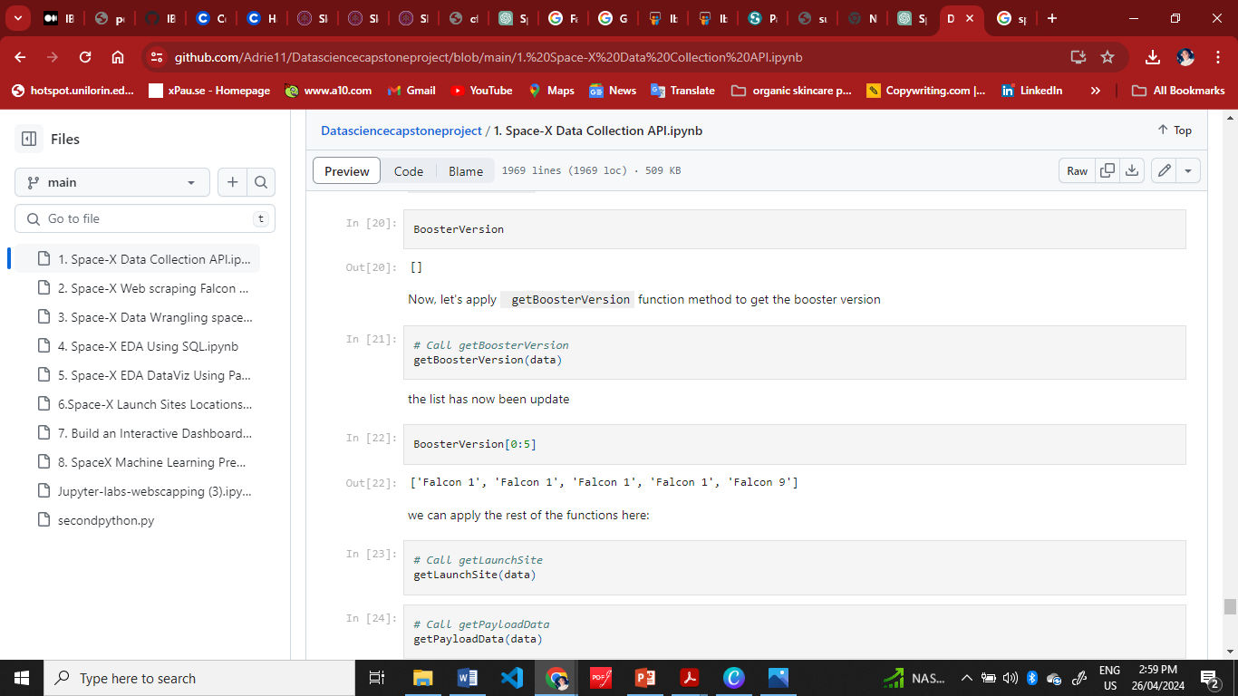
Data Collection – SpaceX API
I collected data using the SpaceX API, which is a RESTful API. First, I made a GET request to the SpaceX API to retrieve launch data. Then, I parsed the response from the API, decoding the JSON content. Finally, I converted this JSON data into a Pandas dataframe for further analysis and manipulation. This allowed me to effectively work with the retrieved launch data within my data science project.
GitHubURL1 of the completed SpaceX API calls notebook as an external reference and peer-review purpose
Place your flowchart of SpaceX API calls here
Notes:
Data collection with Space X REST
GitHub URL of the completed SpaceX API calls notebook https://github.com/Adrie11/Datasciencecapstoneproject/blob/main/1.%20Space-X%20Data%20Collection%20API.ipynb external reference

Slide 9
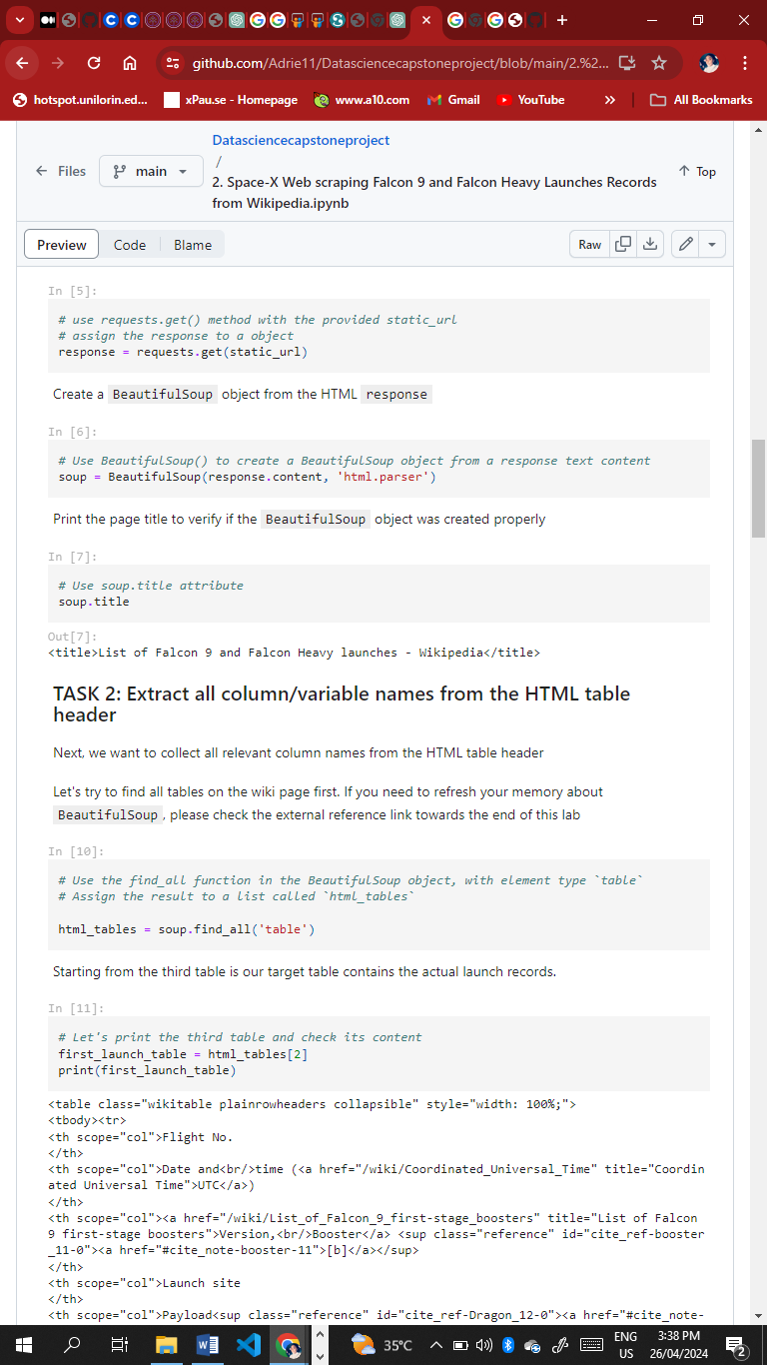
Data Collection - Scraping
I performed web scraping to gather historical launch records of Falcon 9 from a Wikipedia page using BeautifulSoup and requests. This involved extracting the Falcon 9 launch data from an HTML table on the Wikipedia page and then creating a DataFrame by parsing the HTML content.
GitHubURL2 of the completed web scraping notebook, as an external reference and peer-review purpose
Place your flowchart of web scraping here
Notes:
You can find the completed web scraping notebook related to this project on GitHub at the following URL:

Slide 10
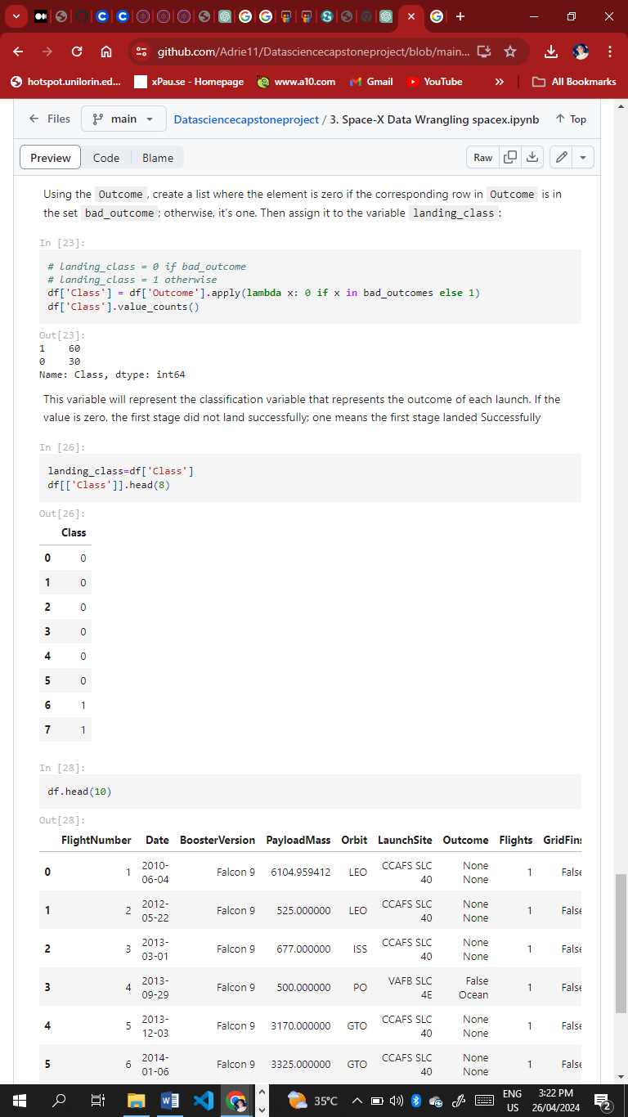
Data Wrangling
After obtaining and creating a Pandas DataFrame from the collected data, I filtered the data using the "BoosterVersion" column to only keep the Falcon 9 launches. Then, I addressed missing data values in the "LandingPad" and "PayloadMass" columns. For the "PayloadMass" column, I replaced the missing values with the mean value of the column.
Additionally, I conducted Exploratory Data Analysis (EDA) to identify patterns in the data and determine the target label for training supervised models.
GitHubURL3 of completed data wrangling related notebooks, as an external reference and peer-review purpose

Slide 11
EDA with Data Visualization
I conducted data analysis and feature engineering using Pandas and Matplotlib as part of my project:
Conducted Exploratory Data Analysis (EDA) to understand the dataset and identify patterns.
Prepared the data through feature engineering to enhance model performance.
Utilized scatter plots to visualize relationships between variables such as Flight Number and Launch Site, Payload and Launch Site, Flight Number and Orbit type, and Payload and Orbit type.
Used bar charts to visualize the success rate of each orbit type.
Employed line plots to visualize the yearly trend of launch success.
•Line plot to Visualize the launch success yearly trend.
GitHub URL4 of completed EDA with data visualization notebook.

Slide 12
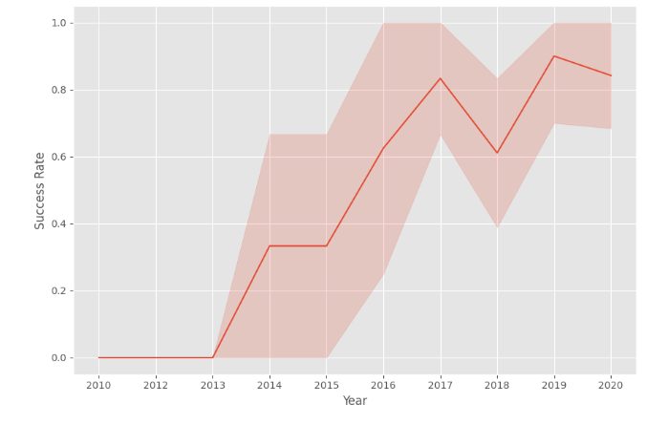
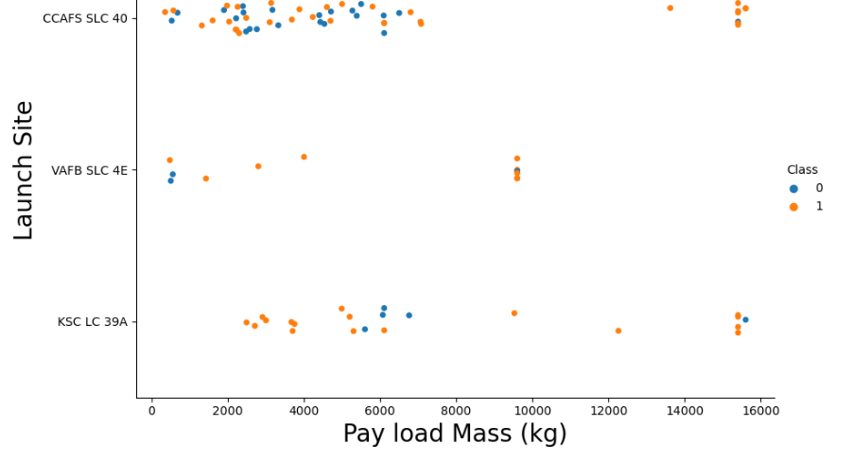
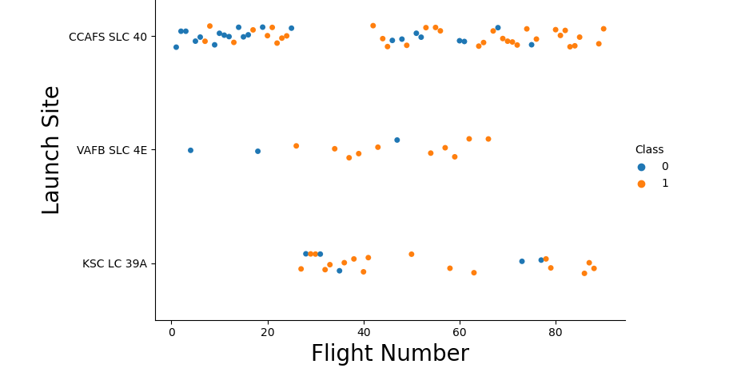
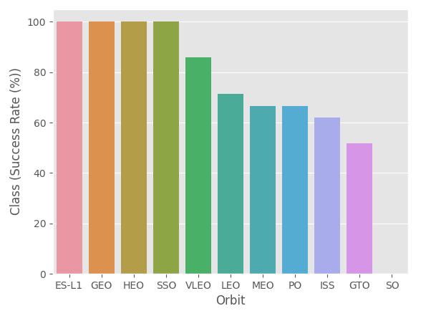
EDA with Data Visualization Continued)

Slide 13
EDA with SQL
Using bullet point format, summarize the SQL queries you performed
Add the GitHub URL of your completed EDA with SQL notebook, as an external reference and peer-review purpose
The following SQL queries were performed for EDA
Display the names of the unique launch sites in the space mission
Notes:
The following SQL queries were performed for EDA
•Task 1
Display the names of the unique launch sites in the space mission
Task 2
Display 5 records where launch sites begin with the string 'CCA'
Task 3
Display the total payload mass carried by boosters launched by NASA (CRS)
Task 4
Display average payload mass carried by booster version F9 v1.1
Task 5
List the date when the first succesful landing outcome in ground pad was acheived.
Task 6
List the names of the boosters which have success in drone ship and have payload mass greater than 4000 but less than 6000
Task 7
List the total number of successful and failure mission outcomes
Task 8
List the names of the booster_versions which have carried the maximum payload mass. Use a subquery
Task 9
List the records which will display the month names, failure landing_outcomes in drone ship ,booster versions, launch_site for the months in year 2015.
Task 10
Rank the count of successful landing_outcomes between the date 04-06-2010 and 20-03-2017 in descending order.

Slide 14
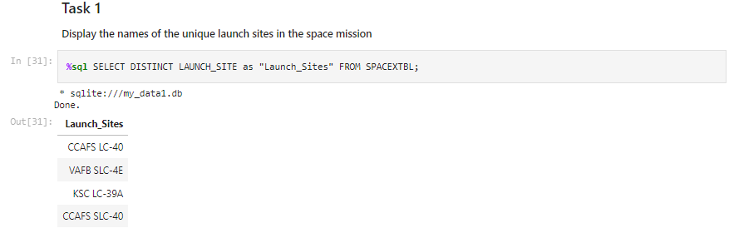
•Task 1 Display the names of the unique launch sites in the space mission

Slide 15
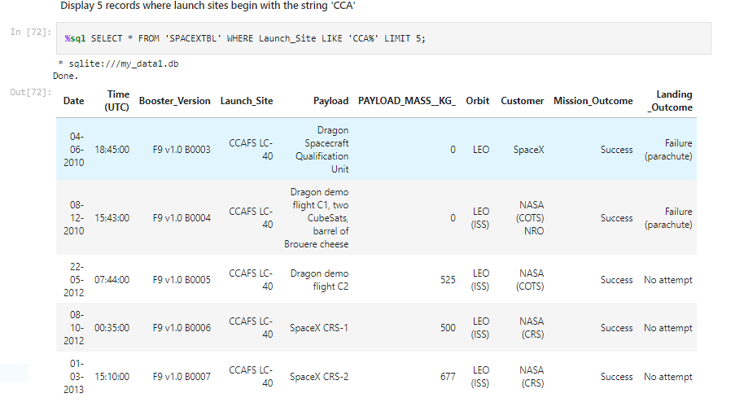
Task 2 Display 5 records where launch sites begin with the string 'CCA'

Slide 16
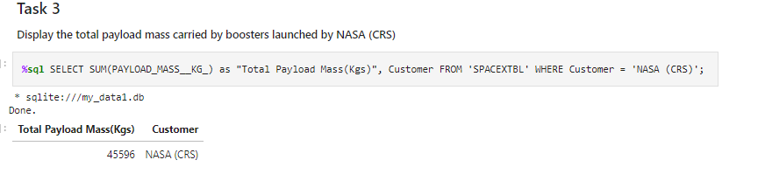
Task 3 Display the total payload mass carried by boosters launched by NASA (CRS)

Slide 17
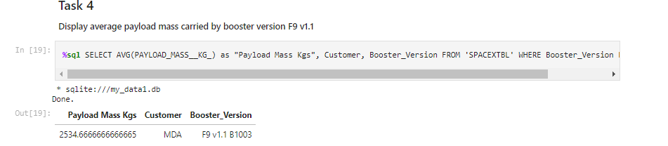
Task 4 Display average payload mass carried by booster version F9 v1.1

Slide 18
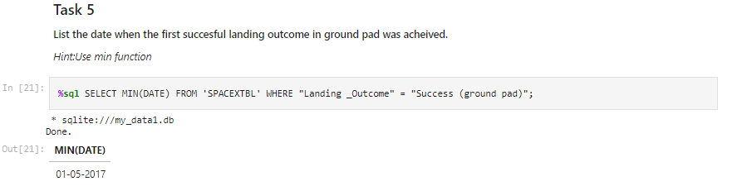
Task 5 List the date when the first succesful landing outcome in ground pad was acheived.

Slide 19
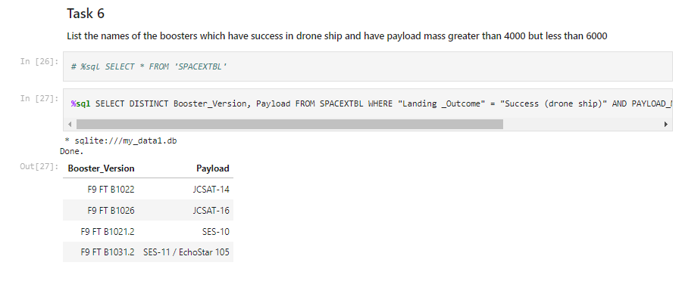
Task 6 List the names of the boosters which have success in drone ship and have payload mass greater than 4000 but less than 6000

Slide 20
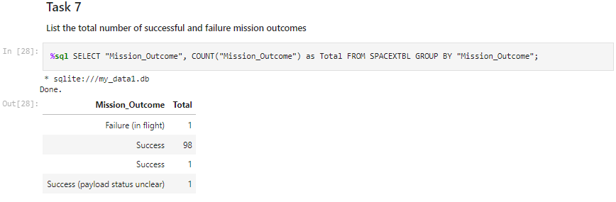
Task 7 List the total number of successful and failure mission outcomes

Slide 21
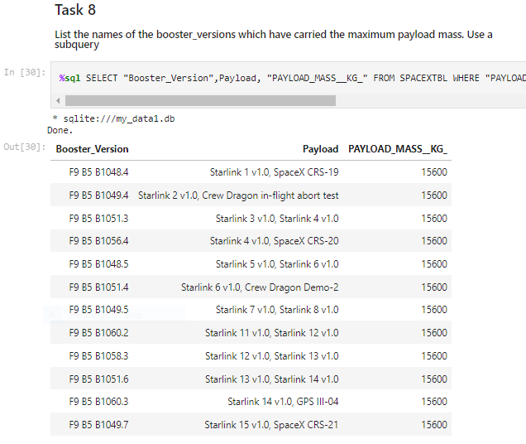
Task 8 List the names of the booster_versions which have carried the maximum payload mass. Use a subquery

Slide 22
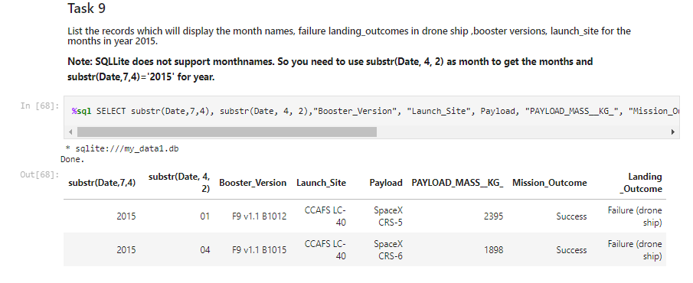
Task 9 List the records which will display the month names, failure landing_outcomes in drone ship ,booster versions, launch_site for the months in year 2015.

Slide 23
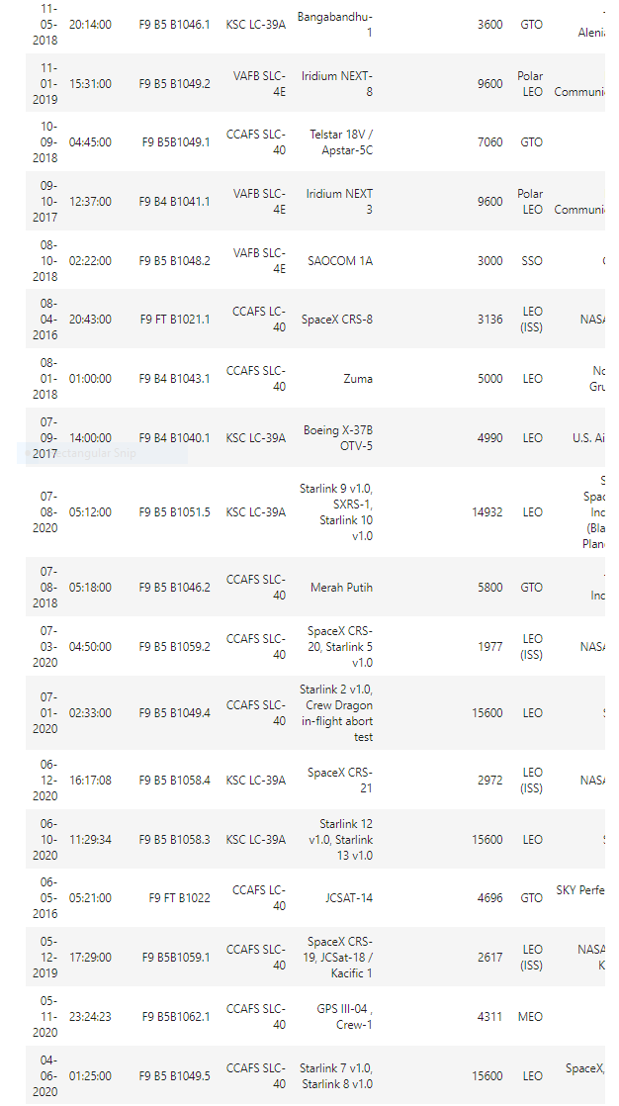
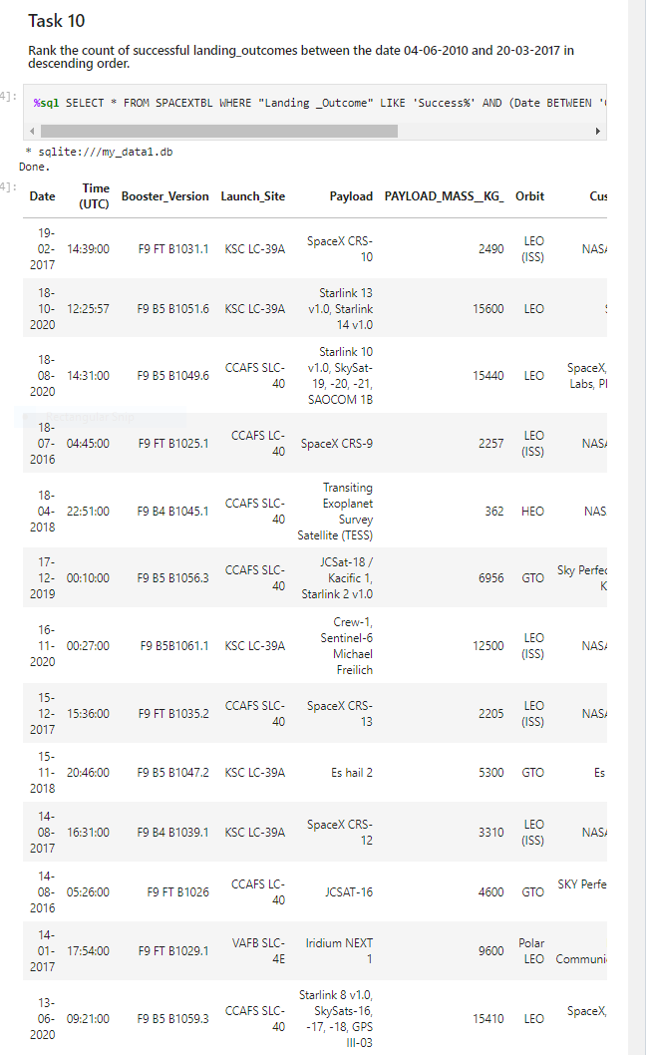
Task 10 Rank the count of successful landing_outcomes between the date 04-06-2010 and 20-03-2017 in descending order.

Slide 24
Build an Interactive Map with Folium
I developed an interactive map using Folium to visualize SpaceX launch sites and their respective launch outcomes. This involved marking all the launch sites on the map and using map objects like markers, circles, and lines to indicate the success or failure of launches at each site.
Additionally, I created a binary launch outcome variable where failure is represented as 0 and success as 1.
You can access the completed interactive map with Folium on GitHub6 for external reference and peer review at this URL

Slide 25
Build a Dashboard with Plotly Dash
I developed an interactive dashboard application using Plotly Dash with the following components and features:
- Integrated a Launch Site drop-down input component to select specific launch sites.
- Implemented a callback function to dynamically render a success-pie-chart based on the selected launch site from the drop-down menu.
- Added a Range Slider to enable selection of payload values.
- Implemented a callback function to display a success-payload-scatter-chart scatter plot based on the selected payload range.
You can view the completed Plotly Dash interactive dashboard lab on GitHub7

Slide 26
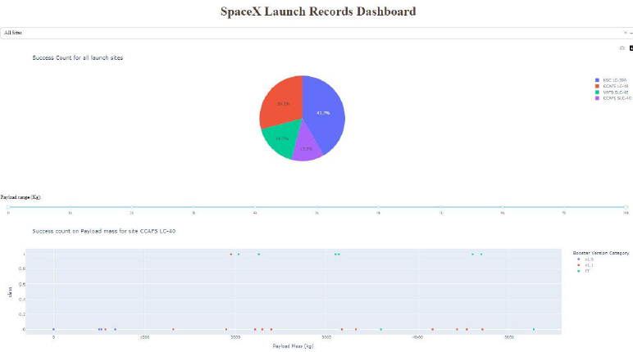
SpaceX Dash App

Slide 27
Predictive Analysis (Classification)
Here's a summary of how I built, evaluated, improved, and identified the best performing classification model for the project:
Loading and Preprocessing Data: - Loaded the data into a Pandas DataFrame, - Created a NumPy array (Y) containing the target variable ("Class") by converting the DataFrame column using the `to_numpy()` method.
Feature Standardization: - Standardized the feature dataset (X) using `preprocessing.StandardScaler()` from the sklearn library. This process helps in normalizing the features to have zero mean and unit variance, which is important for many machine learning algorithms.
Splitting Data for Training and Testing: Split the dataset into training and testing sets using `train_test_split` from `sklearn.model_selection`.
- Set the `test_size` parameter to 0.2, indicating that 20% of the data will be used for testing.
- Used `random_state` parameter set to 2 for reproducibility of the split.
These steps laid the foundation for further model building, training, and evaluation to identify the best-performing classification model for predicting the target variable based on the standardized features. The next stages likely involved selecting and training various classification algorithms, tuning hyperparameters, and evaluating model performance using metrics like accuracy, precision, recall, and F1-score.

Slide 28
Predictive Analysis (Classification) Contd.2
I embarked on a detailed journey to find the best machine learning model for our project using test data. The exploration involved assessing four important algorithms: SVM, Classification Trees, k Nearest Neighbors, and Logistic Regression.
To optimize the performance of each algorithm, I meticulously fine-tuned their parameters using GridSearchCV, tailoring them to our specific needs.
Through 10-fold cross-validation, I trained and validated these models on our dataset, aiming to discover the best hyperparameters for optimal performance.
After the training phase, I carefully analyzed the results to identify the most effective parameters for each model and evaluated their accuracy on validation data.
To ensure practical applicability, I rigorously tested the optimized models on unseen test data. This allowed us to measure real-world performance, calculating accuracy scores and generating confusion matrices for a comprehensive assessment.
This systematic approach enabled us to confidently select the model best suited for our project, equipped with parameters that ensure accuracy and reliability in practical scenarios.

Slide 29
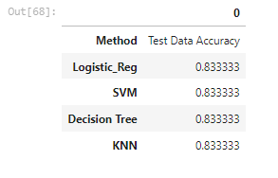
Predictive Analysis (Classification) Cont.d3
The table below shows the test data accuracy score for each of the methods comparing them to show which performed best using the test data between SVM, Classification Trees, k nearest neighbors and Logistic Regression;
GitHubURL8 of the completed predictive analysis lab

Slide 30
Results
Exploratory data analysis results
Interactive analytics demo in screenshots
Predictive analysis results

Slide 31

Section 2

Slide 32
Flight Number vs. Launch Site
Show a scatter plot of Flight Number vs. Launch Site
Show the screenshot of the scatter plot with explanations

Slide 33
Flight Number vs. LaunchSite

Slide 34
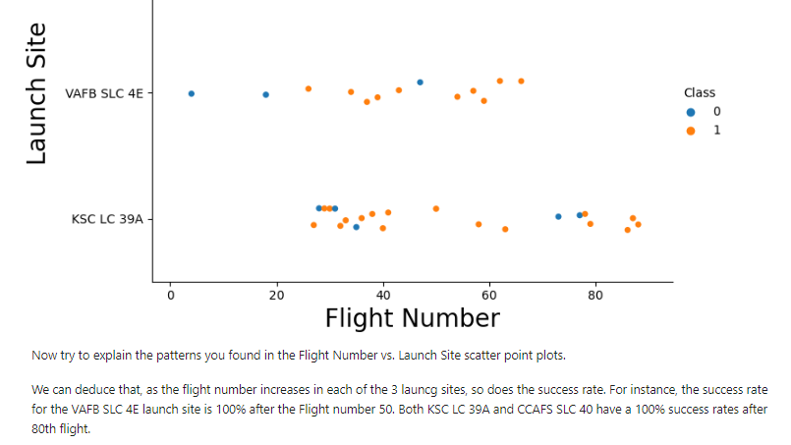
Flight Number vs. LaunchSite with explanations

Slide 35
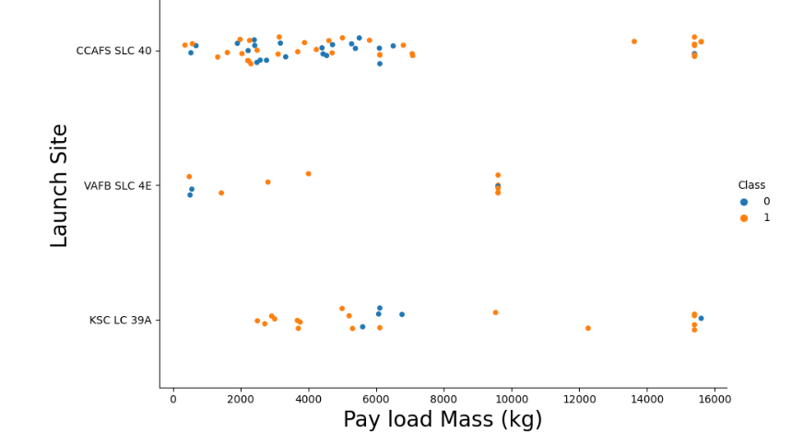
Payload vs. Launch Site

Slide 36
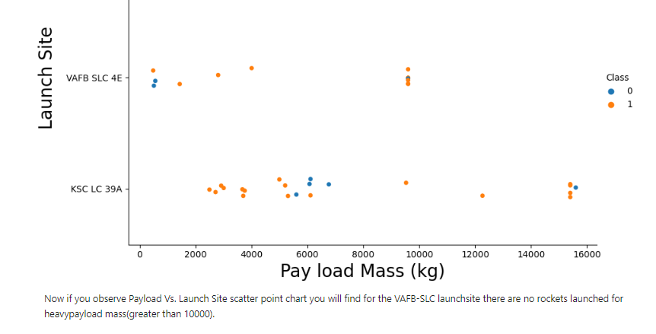
Payload vs. Launch Site with explanations

Slide 37
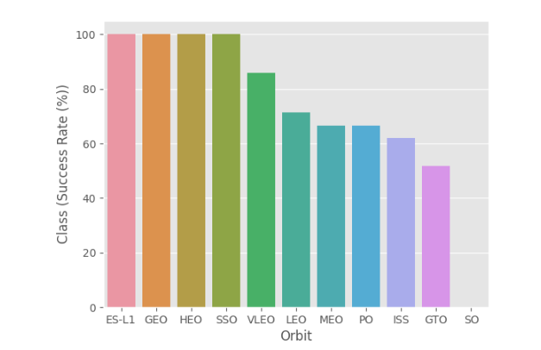
Success Rate vs. Orbit Type
Show a bar chart for the success rate of each orbit type
Show the screenshot of the scatter plot with explanations

Slide 38
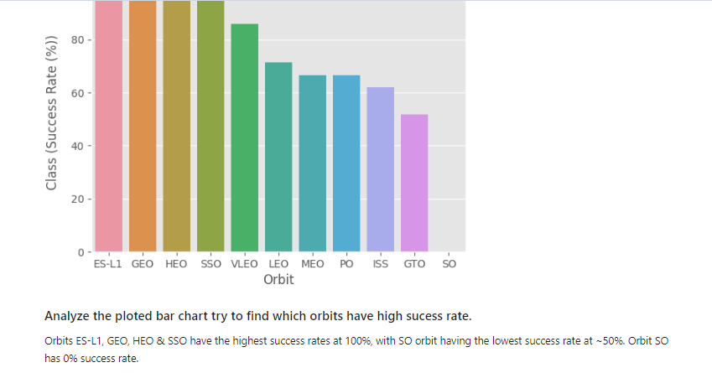
Flight Number vs. Orbit Type
Show a scatter point of Flight number vs. Orbit type
Show the screenshot of the scatter plot with explanations

Slide 39
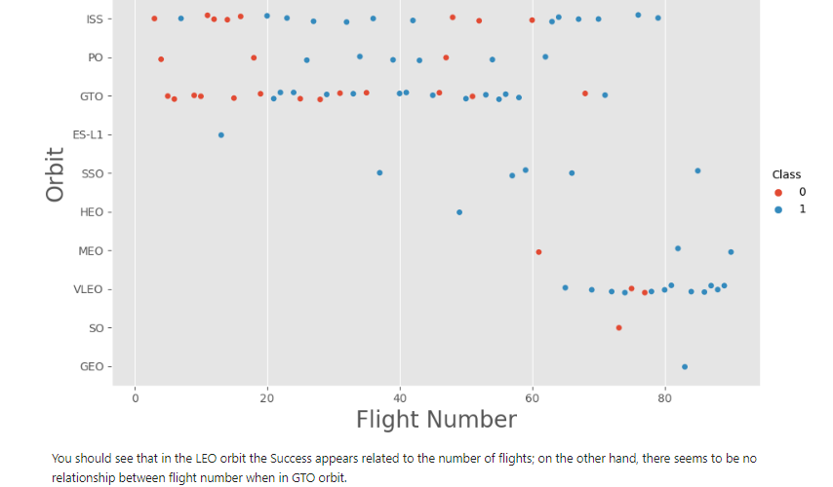
Flight Number vs. Orbit Type with explanations

Slide 40
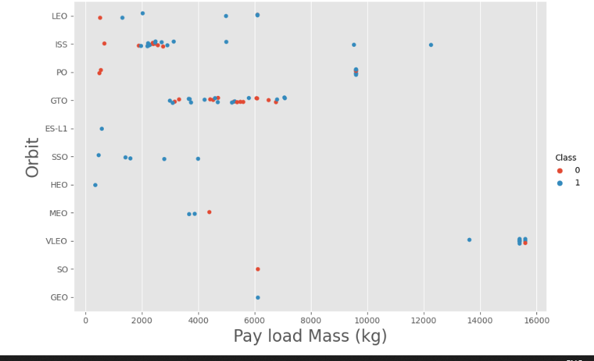
Payload vs. Orbit Type
Show a scatter point of payload vs. orbit type
Show the screenshot of the scatter plot with explanations

Slide 41
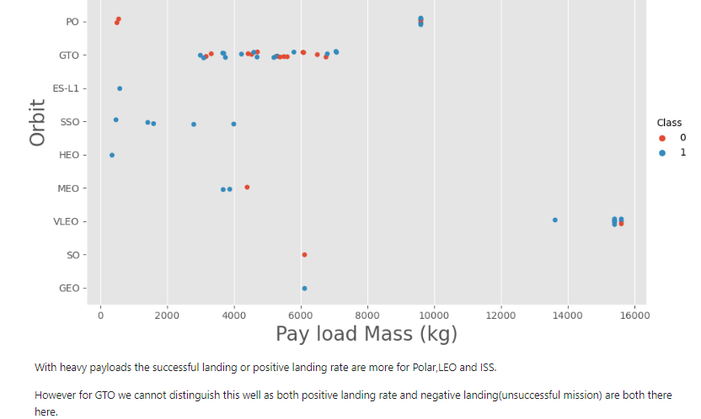
Payload vs. Orbit Type with explanations
scatter plot with explanations
As I examined the data for heavy payloads, I noticed that missions to Polar, LEO (Low Earth Orbit), and ISS (International Space Station) had a higher success rate for positive landings. However, distinguishing between successful and unsuccessful landings for GTO (Geostationary Transfer Orbit) missions was more challenging, as both outcomes had nearly equal probabilities. This finding highlights the significance of considering payload type and mission destination when evaluating the likelihood of successful landings for Falcon 9 missions.

Slide 42
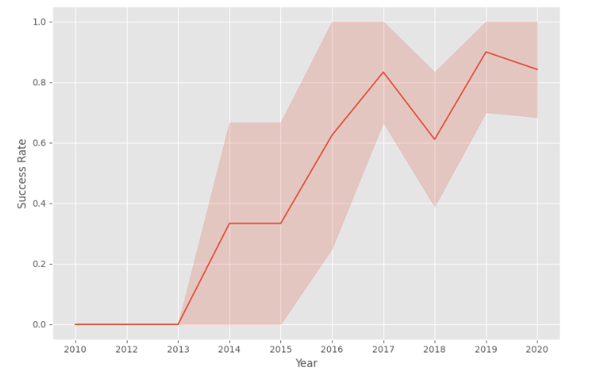
Launch Success Yearly Trend
Show a line chart of yearly average success rate
Show the screenshot of the scatter plot with explanations

Slide 43
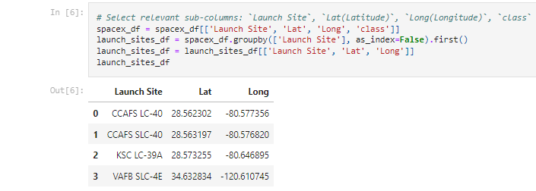
All Launch Site Names
Find the names of the unique launch sites
Present your query result with a short explanation here:
Used ‘SELECT DISTINCT’ statement to return only the unique launch sites from the ‘LAUNCH_SITE’ column of the SPACEXTBL table

Slide 44
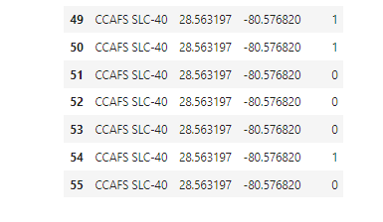
Launch Site Names Begin with 'CCA'
Find 5 records where launch sites begin with `CCA`
Present your query result with a short explanation here:
Used ‘LIKE’ command with ‘%’ wildcard in ‘WHERE’ clause to select and dispay a table of all records where launch sites begin with the string 'CCA'

Slide 45
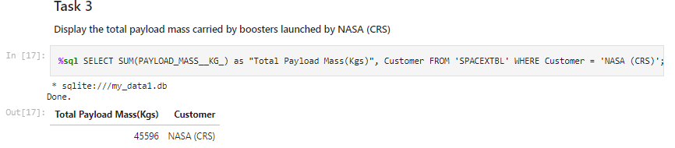
Total Payload Mass
Calculate the total payload carried by boosters from NASA
Present your query result with a short explanation here:
Used the ‘SUM()’ function to return and dispaly the total sum of ‘PAYLOAD_MASS_KG’ column for Customer ‘NASA(CRS’

Slide 46
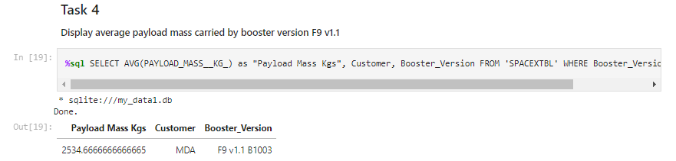
Average Payload Mass by F9 v1.1
Calculate the average payload mass carried by booster version F9 v1.1
Present your query result with a short explanation here:
•Used the ‘AVG()’ function to return and dispaly the average payload mass carried by booster version F9 v1.1

Slide 47
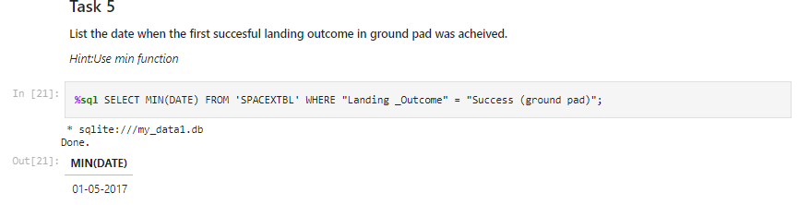
First Successful Ground Landing Date
Find the dates of the first successful landing outcome on ground pad
Present your query result with a short explanation here:
Used the ‘MIN()’ function to return and dispaly the first (oldest) date when first successful landing outcome on ground pad ‘Success (ground pad)’happened.

Slide 48
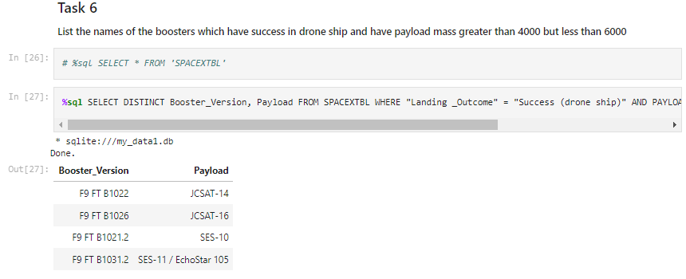
Successful Drone Ship Landing with Payload between 4000 and 6000
List the names of boosters which have successfully landed on drone ship and had payload mass greater than 4000 but less than 6000
Present your query result with a short explanation here:
Used ‘Select Distinct’ statement to return and list the ‘unique’ names of boosters with operators >4000 and <6000 to only list booster with payloads btween 4000-6000 with landing outcome of ‘Success (drone ship)’.

Slide 49
Total Number of Successful and Failure Mission Outcomes
Calculate the total number of successful and failure mission outcomes
Used the ‘COUNT()’ together with the ‘GROUP BY’ statement to return total number of missions outcomes

Slide 50
Boosters Carried Maximum Payload
List the names of the booster which have carried the maximum payload mass
Using a Subquerry to return and pass the Max payload and used it list all the boosters that have carried the Max payload of 15600kgs

Slide 51
2015 Launch Records
List the failed landing_outcomes in drone ship, their booster versions, and launch site names for in year 2015
Used the ‘subsrt()’ in the select statement to get the month and year from the date column where substr(Date,7,4)='2015' for year and Landing_outcome was ‘Failure (drone ship’) and return the records nmatching the filter.

Slide 52
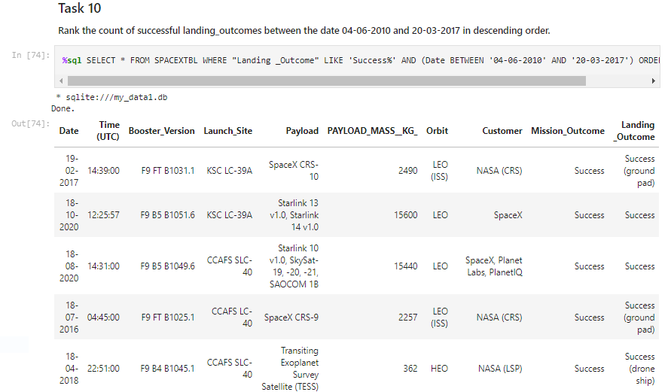
Rank Landing Outcomes Between 2010-06-04 and 2017-03-20
Rank the count of landing outcomes (such as Failure (drone ship) or Success (ground pad)) between the date 2010-06-04 and 2017-03-20, in descending order

Slide 53

Section 3

Slide 54
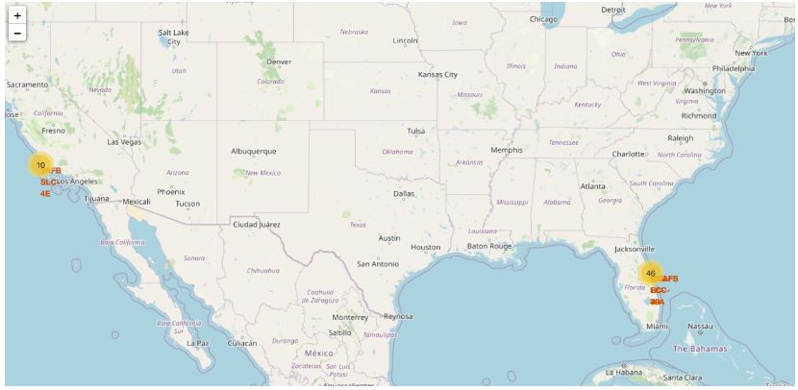
Markers of all launch sites on global map
Explore the generated folium map and make a proper screenshot to include all launch sites’ location markers on a global map
All launch sites are in proximity to the Equator, (located southwards of the US map). Also all the launch sites are in very close proximity to the coast.

Slide 55
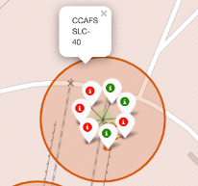
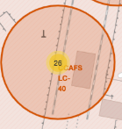
Launch outcomes for each site on the map With Color Markers
Explore the folium map and make a proper screenshot to show the color-labeled launch outcomes on the map
CCAFS SLC-40 has better success rates compared to & CCAFS LC-40.

Slide 56
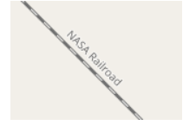
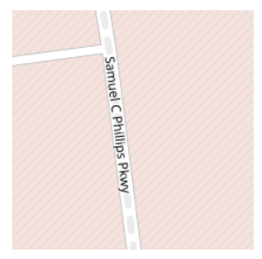
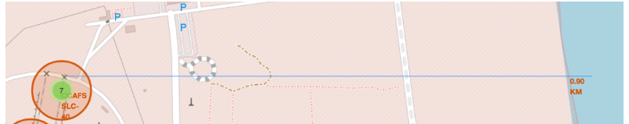
Launch outcomes for each site on the map With Color Markers and Distances between a launch site to its proximities
Florida Sites
Explain the important elements and findings on the screenshot
Launch siteCCAFS SLC-40proximity to coastline is 0.91km

Slide 57

Section 4

Slide 58
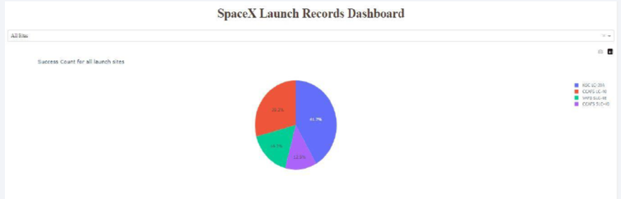
Pie-Chart for launch success count for all sites
Explain the important elements and findings on the screenshot
Launch site KSC LC-39A has the highest launch success rate at 42% followed by CCAFS LC-40 at 29%, VAFB SLC-4E at 17% and lastly launch site CCAFS SLC-40 with a success rate of 13%

Slide 59
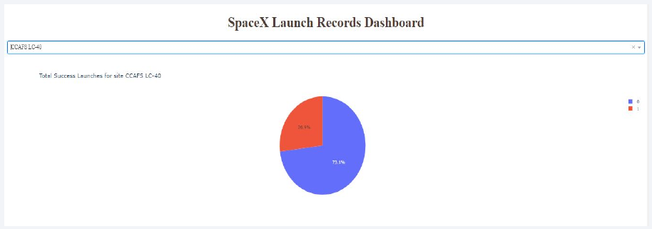
Pie chart for the launch site with 2ndhighest launch success ratio
Show the screenshot of the piechart for the launch site with highest launch success ratio
Explain the important elements and findings on the screenshot
Launch site CCAFS LC-40 had the 2ndhighest success ratio of 73% success against 27% failed launches

Slide 60
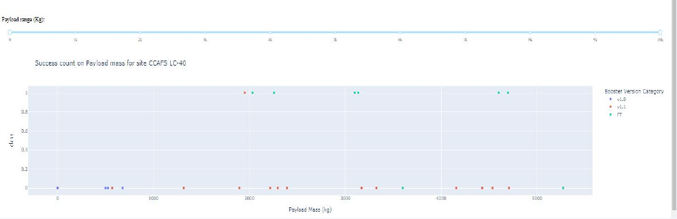
Payload vs. Launch Outcome scatter plot for all sites
Show screenshots of Payload vs. Launch Outcome scatter plot for all sites, with different payload selected in the range slider
For Launch site CCAFS LC-40 the booster version FT has the largest success ratefrom a payload mass of >2000kg

Slide 61

Section 5

Slide 62
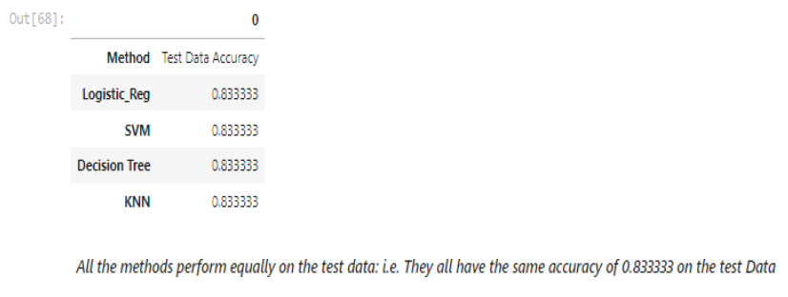
Classification Accuracy
Visualize the built model accuracy for all built classification models, in a bar chart
All methods preform equally on the test data, having an accuracy of 0.833333

Slide 63
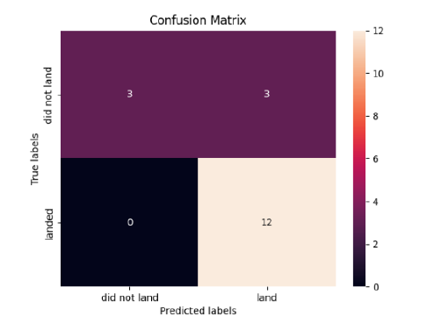
Confusion Matrix
All 4 classification models had the same confusion matrixes and were able equally distinguish between the different classes. The major problem is false positives for all the models.

Slide 64
Conclusions
Different launch sites have different success rates. CCAFS LC-40, has a success rate of 60 %, while KSC LC-39A and VAFB SLC 4E has a success rate of 77%.
We can deduce that, as the flight number increases in each of the 3 launcg sites, so does the success rate. For instance, the success rate for the VAFB SLC 4E launch site is 100% after the Flight number 50. Both KSC LC 39A and CCAFS SLC 40 have a 100% success rates after 80th flight
If you observe Payload Vs. Launch Site scatter point chart you will find for the VAFB-SLC launchsite there are no rockets launched for heavypayload mass(greater than 10000).
Orbits ES-L1, GEO, HEO & SSO have the highest success rates at 100%, with SO orbit having the lowest success rate at ~50%. Orbit SO has 0% success rate.
LEO orbit the Success appears related to the number of flights; on the other hand, there seems to be no relationship between flight number when in GTO orbit

Slide 65
Conclusions Continued
With heavy payloads the successful landing or positive landing rate are more for Polar,LEO and ISS. However for GTO we cannot distinguish this well as both positive landing rate and negative landing(unsuccessful mission) are both there here
And finally the sucess rate since 2013 kept increasing till 2020.

Slide 66


